Slide 2
Background to the WholEUGrain Project
Notes:
To understand how the WholEUGrain project came about, I would like to play a viceo that summerizes the constallation and success of the Danish Wholegrain Partnership
Play Video

Slide 3
The WholEUGrain project
Emanated from the Danish whole grain partnership and its success in increasing the Whole Grain intake in Denmark
Launched in November 2019 and ends in October 2022 = 3 years
Project partners from four different countries:
Denmark (Danish Veterinary and Food Administration and The Danish Cancer Society)
Bosnia and Herzegovina (Ministry of Civil Affairs of Bosnia and Herzegovina, The Institute of Public Health of the Federation of Bosnia and Herzegovina and Institute of Public Health of the Republic of Srpska)
Slovenia (Chamber of Commerce and Industry of Slovenia – Chamber of Agricultural and Food Enterprises)
Romania (National Institute Of Public Health in Romania
Notes:
Emanated from the Danish Whole grain partnersip and its success in increasing the whole grain intake in Denmark and aims to disseminate experiences from the Danish Whole Grain Partnership to other European Countries, in order to provide the necessary competencies and knowledge to initiate and run a public-private partnership to increase the intake of whole grain in the population that is suitable for the specific context.
The WholEUGrain project was launched in November 2019 and will end in October 2022
The project consist of four different countries; Denmark, Romania, Slovenia and Bosnia and Herzegovina. However, other countries are able to follow the project and thereby benefit from this action through different activities like for instance the spring school today.
The WholEuGrain project includes partners from both the industry, NGO’s and ministries. It’s important to have both the industry, NGO’s and ministries included as projects partners as it strengthen the cooperation and make sure that all sides of the story is being told and that all experiences can be reflected in gathering experiences and lessons learned to develop and establish whole grain partnerships in the project partner countries.
The focus on the first two years of the project has been on developing the tools needed for establishing the national whole grain partnership. The focus for the last year of the project will be on knowledge sharing and establishing the national whole grain partnerships in the project partner countries

Slide 4
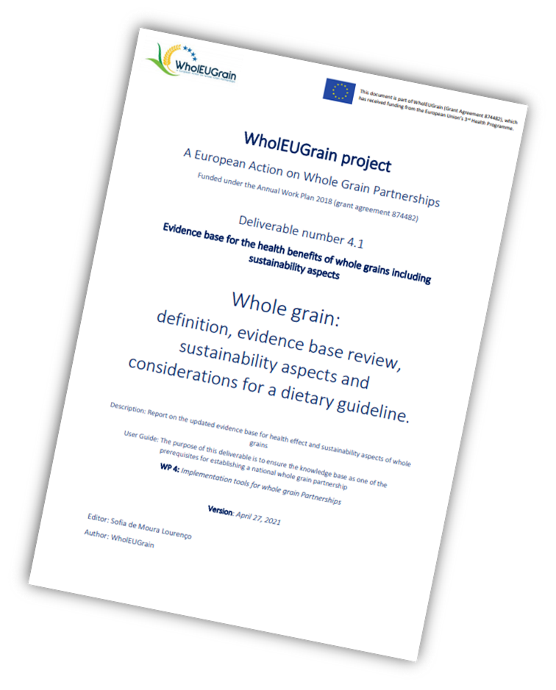
Tailored Transfer and Implementation Tools
Consultations to assist the project partners in establishing their own whole grain partnerships
Stakeholder events
EU guideline
Notes:
In order to provide the necessary competencies and knowledge to initiate and run a whole grain partnership, the project has developed tailored transfer tools to facilitate this process.
One of the most important deliverables under the WholEUGrain project is the updated evidence-base. The evidence base considers the definition of whole grains and whole-grain products, it reviews the evidence regarding the health benefits of whole-grain consumption, provides insight into the sustainability aspects of whole grains, and gathers knowledge of relevant aspects necessary to the establishment of national recommendations for whole-grain consumption and has the primary intention of making the project partners take informed decisions.
Another important tool is the Toolbox developed by the Danish cancer society, which is a collection of insights and experiences from the Danish WGP that aims to equip national initiatives with the tools necessary to establish wholegran partnerships. It has been translated into Bosnian and i will strongly encourage all of you to read through it.
Through five chapters it adresses how to develop, maintain and sustainaBLE a public private partnership – including step-by-step guide that will take you through the several steps in the process from the establishment of a public private whole grain partnership to the running and maintenance of it.
It also has a chapter on the evidence base for reocmmendations and health effects of whole grain – including references for additional ressources
How to assess food culture, monitoring markets, consumer knowledge attitudes and behavior
Consumer communication, public awareness campaigns and labelling
And lastly a chapter on product development , reformulation and quality.
In order to convert the theory of these two aforementioned tools into practice the project also carries out consultations and knowledge-sharing events like this spring school. This can either be consultaitons with expert advice on subjects that are relevant to all project partners or it can be 1:! Consultations that are tailored to the specific needs of a project partner.
The project has previously hosted a stakeholder network seminar and will be hosting additional events to inspire and engage other stakeholders interested in working with whole grain or establishing a PPP.
Lastly all of the different experiences from the project and project countrries will be compiled into an EU guideline, which aims to help other (EU) countries learn from the lessons learned and best practices to take the next steps towards their own whole grain partnership

Slide 5
If you want to engage or know more visit our Project website
https://www.gzs.si/wholeugrain/
wholeugrain@fvst.dk
Notes:
If you want to know more about the project you can visit the project website where you can find all the tools, project deliverables and recordings of last year’s summer school and stakeholder webevent.
You can also subscribe to our newsletter and follow us on social media such as facebbok and Linkedin.
Please also feel free to reach out to us by mail.

